Slide 1

SIT105 - Critical Thinking and Problem Solving for IT Class 08
Part 1 – Repetition Statements
Part 2 – Modularisation
Dr. Frank Jiang
Frank.Jiang@deakin.edu.au

Slide 2

Part 1 Content
Selection Concept – Reminder
Repetition Concept
DOWHILE Statement
REPEAT Statement
DO Statement

Slide 3

Quote
There is a construct in computer programming called 'the infinite loop' which enables a computer to do what no other physical machine can do: to operate in perpetuity without tiring.
In the same way it doesn't know exhaustion, it doesn't know when it's wrong and it can keep doing the wrong thing over and over without tiring.
Quote by: John Maeda
Japanese-American graphic designer, computer scientist, academic, and author.

Slide 4

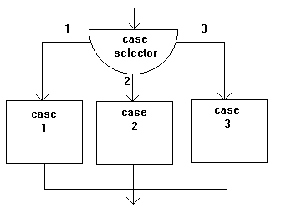
Selection Concept – Reminder
Selection statements are used to select and evaluate one embedded group of statements and so ignore other embedded groups.
2 Possible Selection Choices
IF Statement
Case Statement

Slide 5

Repetition Concept
A repetition statement is used to continually evaluate one group of statements
The value of an explicit Boolean expression is used to either:
Terminate the continual evaluation (stop the loop)
Evaluate the group one more time
"Something that is explicit is expressed or shown clearly and openly, without any attempt to hide anything"

Slide 6
Let’s take a look at the following repetition statements!
DOWHILE Statement
REPEAT Statement
DO Statement

Slide 7
DOWHILE Statement
Format
DOWHILE Boolean expression
statements
ENDDO
The blue block is executed first.
The green block is executed after the blue block, but only when the blue block has a TRUE value.
After executing the last statement in the green block, we restart back at the blue block.

Slide 8
DOWHILE Statement - Example 1
age = 21
IF age >= 18 THEN
PRINT “voter”
ENDIF
DOWHILE age >= 18
PRINT age
age = age - 1
ENDDO
PRINT “Age is ”, age
 | age | condition | output
assignment | 21
IF … | 21 | true
PRINT… | 21 |  | voter
DOWHILE … | 21 | true
PRINT… | 21 |  | 21
Decrement | 20
DOWHILE … | 20 | true
PRINT… | 20 |  | 20
Decrement | 19
DOWHILE … | 19 | true
PRINT… | 19 |  | 19
Decrement | 18
DOWHILE … | 18 | true
PRINT… | 18 |  | 18
Decrement | 17
DOWHILE … | 17 | false
PRINT… | 17 |  | Age is 17
Page 8

Slide 9
DOWHILE Statement - Example 2a
age = 13
DOWHILE age >= 13 AND age <= 19
PRINT age
age = age + 1
ENDDO
PRINT “end”
age
13
14
15
16
17
18
19
20
output
13
14
15
16
17
18
19
end

Slide 10

DOWHILE Statement - Example 2b
// using constants
// for maintenance
LOWER_LIMIT = 13
UPPER_LIMIT = 19
age = LOWER_LIMIT
DOWHILE age >= LOWER_LIMIT AND age <= UPPER_LIMIT
PRINT age
age = age + 1
ENDDO

Slide 11
DOWHILE Statement - Example 3a
LOWER_LIMIT = 13, UPPER_LIMIT = 19, MINIMUM_AGE = 0
PRINT “Please type an age value: ”
READ age
DOWHILE age >= MINIMUM_AGE // don’t do the loop if its negative
IF age >= LOWER_LIMIT AND age <= UPPER_LIMIT THEN
PRINT age, “ is a teenager value”
ENDIF
PRINT “Please type an age value: ”
READ age // get the next age value
ENDDO

Slide 12
DOWHILE Statement - Example 3b
LOWER_LIMIT = 13, UPPER_LIMIT = 19, MINIMUM_AGE = 0
age = MINIMUM_AGE // ensure that the loop runs
DOWHILE age >= MINIMUM_AGE // repetition statement
PRINT “Please type an age value: ”
READ age // read is done inside the DOWHILE only
IF age >= LOWER_LIMIT AND age <= UPPER_LIMIT THEN
PRINT age, “ is a teenager value”
ENDIF
ENDDO

Slide 13
REPEAT Statement
Format
REPEAT
statement
UNTIL Boolean expression
The green block is executed first.
The blue block is executed after the green block.
If the blue block has a False value, we restart back at the green block.
In this, the statement will always be executed at least once
As where WHILEDO the statements may never execute.

Slide 14
REPEAT Statement - Example 1
VOTING_AGE = 18, MINIMUM_AGE = 0
age = 21
IF age >= VOTING_AGE THEN
PRINT “voter”
ENDIF
REPEAT
PRINT age
age = age - 1
UNTIL age < MINIMUM_AGE
PRINT “Age is ”, age
What is this doing?
// keep doing statements until true
// only do this once condition is true

Slide 15
REPEAT Statement - Example 2
LOWER_LIMIT = 13, UPPER_LIMIT = 19
age = LOWER_LIMIT
REPEAT
PRINT age
age = age + 1
UNTIL age < LOWER_LIMIT OR age > UPPER_LIMIT

Slide 16

HEADS UP – “REPEAT” statement in C
do
statement
while ( expression );
Evaluate the statement
Evaluate the expression
On a true value, go back to 1 A false value causes loop termination

Slide 17
DO Statement
Value TO Value = range
The blue block is executed first. At first the initialValue is assigned to the variable.
Format 1
DO variable = initialValue TO finalValue
statement
ENDDO
The green block is executed after the blue block.
After executing the green block; if the variable’s value is less than the finalValue, add 1 to the variable and re-execute the green block.
That ‘variable’ gets the ‘intialValue’ first. Then the next number in the range gets assigned to it and so on.
We know how many times we want to repeat.

Slide 18
DO Statement - Example 1a
 | age | condition | output
DO initailise | 13
PRINT… | 13 |  | 13
DO step | 14
DO condition | 14 | True (as 14<=19)
PRINT… | 14 |  | 14
DO step | 15
DO condition | 15 | True (as 15<=19)
PRINT… | 15 |  | 15
DO step | 16
DO condition | 16 | True (as 16<=19)
ETC
ETC
PRINT… | 19 |  | 19
DO step | 20
DO condition | 20 | False (as 20>19)
// Display all teenage values
DO age = 13 TO 19
PRINT age
ENDDO

Slide 19
DO Statement - Example 1b
// Display all teenage values
// Same thing just using our CONSTANTS
INITIAL_VALUE = 13
FINAL_VALUE = 19
DO age = INITIAL_VALUE TO FINAL_VALUE
PRINT age
ENDDO

Slide 20
DO Statement
The blue block is executed first. At first the initialValue is assigned to the variable.
Format 2
DO variable = initial TO final STEP stepValue
statement
ENDDO
The green block is executed after the blue block.
After executing the green block; if the variable’s value is less than the finalValue, add stepValue to the variable and re-execute the green block.
In this statement we have ‘STEP’ which allows us to adjust the value we step up by.
Default is 1.

Slide 21
DO Statement - Example 2a
// Display 100, 105, 110, 115, 120 and 125
DO x = 100 TO 125 STEP 5
PRINT x
ENDDO

Slide 22
DO Statement - Example 2b
// Display 100, 105, 110, 115, 120 and 125
// Same thing just using CONSTANTS
INITIAL_VALUE = 100
FINAL_VALUE = 125
STEP_VALUE = 5
DO x = INITIAL_VALUE TO FINAL_VALUE STEP STEP_VALUE
PRINT x
ENDDO

Slide 23
DO Statement
The blue block is executed first. At first x is assigned to the variable.
Format 3
DO variable = x DOWNTO y STEP z
statement
ENDDO
Stepping down instead of up.
Start at a higher value then count down.
The green block is executed after the blue block.
After executing the green block; if the variable’s value is greater than y, subtract z from the variable and re-execute the green block.

Slide 24
DO Statement - Example 3
// Display 20, 18, 16, 14, 12 and 10
DO x = 20 DOWNTO 10 STEP 2
PRINT x
ENDDO

Slide 25
DO Statement - Example 4 (version 1)
// Determine and display the
// 2 times table
PRINT “2 * 1 = “, 2 * 1
PRINT “2 * 2 = “, 2 * 2
PRINT “2 * 3 = “, 2 * 3
PRINT “2 * 4 = “, 2 * 4
…
PRINT “2 * 12 = “, 2 * 12
Expected Output
2 * 1 = 2
2 * 2 = 4
2 * 3 = 6
2 * 4 = 8
2 * 5 = 10
2 * 6 = 12
2 * 7 = 14
2 * 8 = 16
2 * 9 = 18
2 * 10 = 20
2 * 11 = 22
2 * 12 = 24

Slide 26
DO Statement - Example 4 (version 2)
// Determine and display the 2 times table
timesTable = 2
PRINT “2 * 1 = “, timesTable * 1
PRINT “2 * 2 = “, timesTable * 2
PRINT “2 * 3 = “, timesTable * 3
PRINT “2 * 4 = “, timesTable * 4
…
PRINT “2 * 12 = “, timesTable * 12

Slide 27
DO Statement - Example 4 (version 4)
// Determine and display the 2 times table
timesTable = 2
DO n = 1 TO 12
product = timesTable * n
PRINT timesTable, “ * “, n, “ = “, product
ENDDO

Slide 28
DO Statement - Example 5
// Determine and display the 2 and 3 times tables
timesTable = 2
DO n = 1 TO 12
product = timesTable * n
PRINT timesTable, “ * “, n, “ = “, product
ENDDO
timesTable = 3
DO n = 1 TO 12
product = timesTable * n
PRINT timesTable, “ * “, n, “ = “, product
ENDDO
Just alter this to do the 3x times table

Slide 29

HEADS UP – “DO” statement in C
Do statement is a for statement in C
C
for(expression1; expr2; expr3)
statement
Pseudocode
expression1
DOWHILE expr2
statement
expr3
ENDDO
C example
sum = 0;
for(n = 1; n <= 10; n = n + 1)
sum = sum + n;
Pseudocode example
sum = 0
n = 1
DOWHILE n <= 10
sum = sum + n
n = n + 1
ENDDO

Slide 30

Part 2 Content
Top Down Method
What is a Module
Modular Programming
Good Features of a Module
Benefits of Good Module Design
The Main Module
Module Execution
Hierarchy Charts

Slide 31

Top Down Method (Technique)
A top down method is to design a solution.
Divide a single task into several smaller subtasks
Divide these subtasks into smaller subtasks
Continually divide subtasks until they:
represent one logical / valid task
are at a manageable size
Each task / subtask is considered to be a module

Slide 32

What is a Module
Modular programming is the process of subdividing a computer program.
So: A module is a separate software component.
A module can often be used in a variety of programs.
Allows for boundaries and improves maintainability.
It enables multiple programmers to divide up the work and debug pieces of the program independently.
Teams can develop modules separately and do not require knowledge of all modules in the system.

Slide 33
Modular Programming?
must perform its task
must not do anything unrelated to its task
must always start the code at its top
should only have an exit at its end
must have a meaningful name to describe its task
must have appropriate:
cohesion (see chapter 10) //next week
Things that belong together should be kept together.
coupling (see chapter 10) //next week
One object doesn't directly change or modify the state or behavior of another object.

Slide 34
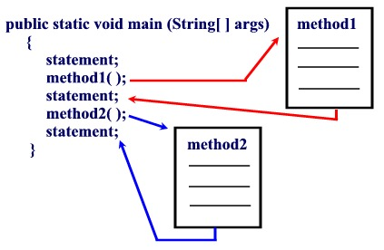
Module Example

Slide 35
Benefits of Good Module Design
Improves Understanding!
Each module should be based on performing one logical task.
E.g. login module has nothing to do with the print module.
Improves Reusability!
A module might be used several times in a program. but also within other programs.
E.g. We have been reusing the ‘PRINT’ module a lot so far in our algorithms.

Slide 36

Benefits of Good Module Design
Removes Redundancy
Use one module instead of duplicating the same code several times in a program.
E.g. just use the PRINT module and not create multiple to do the same thing.
Improves Maintenance
Each module has little or no dependency on other modules.
E.g. If you buy a new TV remote control, do you really want to change the TV also? You want them to be independent…. ideally.

Slide 37
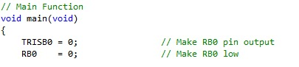
The Main Module
Where the program starts!
Name of the first function in most coding languages is called Main()
An algorithm shall have one main module (its where the algorithm starts).
The main module controls other modules.
Execution of the algorithm:
always starts at the first line of the main module
calls other modules and executes code statements
finishes at the end (last line of the program)

Slide 38
The Main Module
The name of the main keyword highlights its the main task of the program.
If the names of the other modules are sensible, you should be able to:
read the pseudocode of the main module, and
understand what the program does.
Example

Slide 39
The Main Module (example)
By examining this main module one can understand its overall task.
CREATE_PATIENT_BILL
INITIALISE_BILL_VARIABLES
OPEN patient_file
DOWHILE (READ patient_record SUCCEEDS)
COMPUTE_ACCOMODATION_BILL
COMPUTE_SURGERY_BILL
COMPUTE_PATHOLOGY_BILL
WRITE_PATIENT_BILL
UPDATE_OVERALL_TOTALS
ENDDO
CLOSE patient_file
PRINT total_patients, overall_totals
END
Loop through each record of the file.
Inside the loop we work out the bill values.
Write a patients bill and update some totals.
Close file and print.

Slide 40
Module Execution
When executing statements in module A and
if we come across the name of a module B:
suspend execution of module A
start executing statements of module B
When module B finishes:
terminate module B
resume execution of module A

Slide 41
Module Execution (example)
CREATE_PATIENT_BILL
INITIALISE_BILL_VARIABLES
OPEN patient_file
WHILE (READ patient_record SUCCEEDS)
COMPUTE_ACCOMODATION_BILL
COMPUTE_SURGERY_BILL
COMPUTE_PATHOLOGY_BILL
WRITE_PATIENT_BILL
UPDATE_OVERALL_TOTALS
END
CLOSE patient_file
PRINT total_patients, overall_totals
END
INITIALISE_BILL_VARIABLES
accomodation_bill = 0
surgery_bill = 0
pathology_bill = 0
total_accomodation_bill = 0
total_surgery_bill = 0
total_pathology_bill = 0
overall_totals = 0
END
… (other modules)

Slide 42
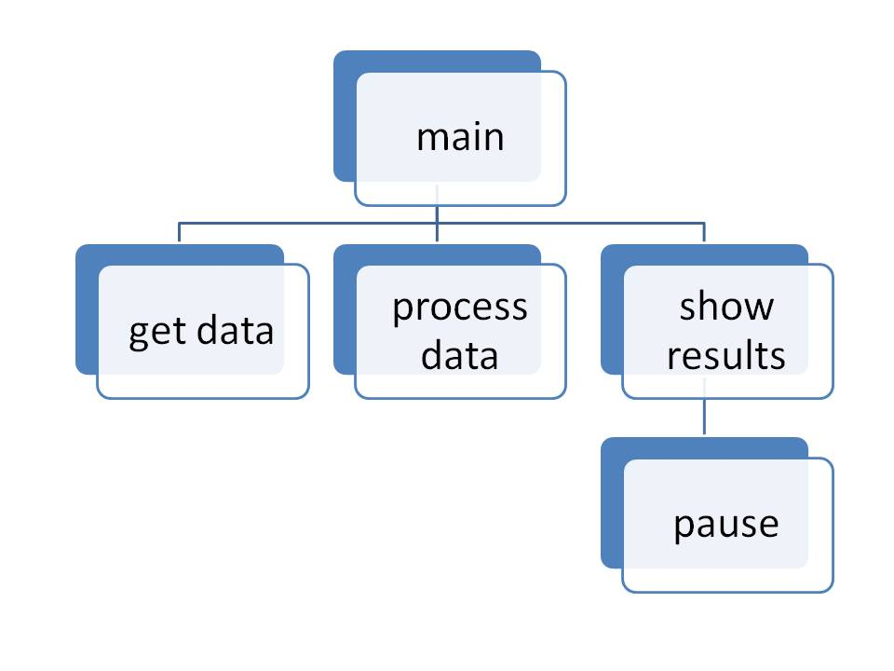
Hierarchy Charts (Structure Charts )
Design tool ☺
Show which modules (potentially) call other modules
May show parameters i.e., data flow from one module to another
Does NOT show algorithm details!

Slide 43
Hierarchy Charts
A module in a chart is called by the module above it which is connected by a line.
Modules at the same level are called from left to right.
A module calls its children modules before its sibling is called.
main_module
module_2
module_3
module_4
module_5
module_6
module_7

Slide 44
Hierarchy Charts
The previous chart can be represented by the following pseudocode.
module_2
…
module_5
…
module_6
…
END
module_3
…
END
main_module
…
module_2
…
module_3
…
module_4
…
END
module_5
…
END
module_6
…
END
module_4
…
module_7
…
END
module_7
…
END
Module 3, 5, 6, 7 Start no other module!

Slide 45
Hierarchy Charts
For an algorithm which is described by the above chart, a possible order in which those modules are called is:
main_module
module_2
module_5
module_6
module_3
module_4
module_7
Why is this order one possible order of many?
Depends if each module meets the right condition to get called into action.

Slide 46
Hierarchy Charts (example with data)
Convert the following pseudocode to a hierarchy chart, include data and modules.
DISPLAY_2_RECTANGLE_AREAS //main module
GET_LENGTH width //whatever is returned from GET_LENGTH
GET_LENGTH height //is place inside variables
RECTANGLE_AREA area1, width, height
GET_LENGTH width
GET_LENGTH height
RECTANGLE_AREA area2, width, height
PRINT area1
PRINT area2
END
We can see here from the Main module what the program is about.
Get some numbers, work out an area and then display them.

Slide 47
Hierarchy Charts (example with data)
This just represents the value coming from the module
DISPLAY_2_RECTANGLE_AREAS
length
width
area
height
area
GET_LENGTH
RECTANGLE_AREA
PRINT
string
length
Only need to diagram 1 PRINT
PRINT
READ

